Slide 2
Computer vision.
Subtitle or speaker name

Slide 3
Custom Vision & Essential Tips and Tricks
Eng.Youssef_khalaf

Slide 4
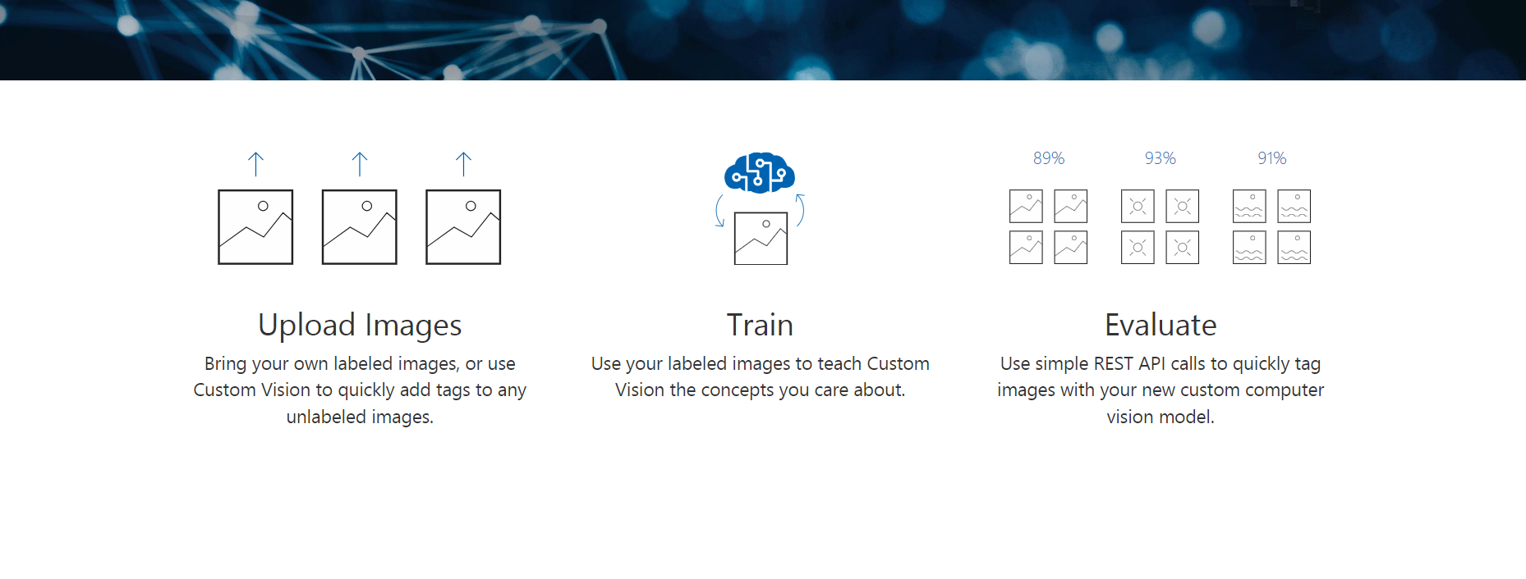
The Steps of Custom Vision

Slide 5
Let’s dive into our work in Azure

Slide 6
Tips:
The section will give you some of tips when creating any project in CV
1-Before doing any projects think in what that’s project will help the people
2-When dealing with CV you dealing with the concept of Vision of human but you do it in your own computer mean that anything your vision hard to do and your brain hard to process it’s impossible your computer do when using CV but if you get into quantity the computer is for sure the winner but the quality of processing and get the result your brain is incredible in it.
3-To get high accuracy and accurate result you have to 3 roads to walk
1-Preprocessing step especially when dealing with images
2-Tunning the hyper params in your model
3-Make a powerful architecture to your model
Notes:
When working with Computer Vision (CV), you're essentially translating the human concept of vision into your computer's language. This means that tasks which may be challenging for your own eyes and brain to process could be deemed impossible for a computer to handle through CV alone. However, while computers excel in processing vast quantities of data, the quality of comprehension and output often surpasses that of machines when guided by the human brain. To achieve high accuracy and precise results in your CV projects, there are three essential paths to follow:
Preprocessing: This initial step is especially crucial when dealing with images. Ensuring that your data is clean, standardized, and appropriately prepared sets a solid foundation for accurate analysis.
Hyperparameter Tuning: Fine-tuning the parameters of your model is paramount. Adjusting these parameters optimally enhances the performance of your CV algorithms, leading to more accurate outcomes.
Architectural Design: Crafting a robust and efficient architecture for your model is key. By designing a powerful framework that effectively processes input data, you pave the way for superior results in your CV projects.

Slide 7
Tips:
3-Filters is the core of CV that If you good with filters You will do a powerful model
4-very intensive neural network you while cost alots in result and recourses too

Slide 8
The Last tip:
6- Absolutely, the data, particularly when it comes to images, is the cornerstone of any Computer Vision project. Without high-quality data, even the most sophisticated algorithms can produce meaningless or misleading results. Therefore, ensuring that your dataset is meticulously curated, free from noise, and accurately represents the task at hand is paramount to the success of your CV project. Remember, in the world of Computer Vision, "garbage in, garbage out" holds true—meaning that the quality of your output is directly influenced by the quality of your input data.

Slide 9
Trikes:
1-When importing data, ensure it's structured correctly. For tasks like multi-class classification, utilize labels for iteration and arrays for storage. This ensures efficient handling and organization of data for your project's needs.
2-Displaying samples of your preprocessing steps is essential for understanding the transformations applied to the data. It provides clarity on the modifications made and ensures transparency in your workflow.
3-Data augmentation is crucial but should be applied solely to the training set.

Slide 10
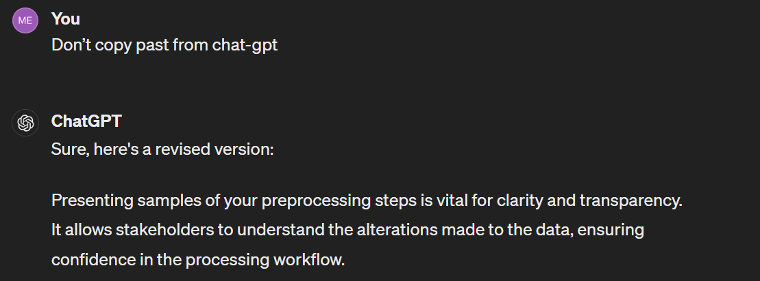
Trikes:
Don’t copy past from chat-gpt
Like the image it doesn’t give you the right answer always
6-If you encounter a problem that can be effectively solved using traditional machine learning techniques, there's no need to resort to deep learning.

Slide 11


Slide 12
Thank You.

